Slide 1


2024 HCA Single-Cell Omics in-person Computational and Experimental Design Workshop Single-cell multiomics: immune repertoire
June 24-28, 2024
Bangkok, Thailand

Slide 2
Computational track schedule
 | Beginner | Advanced
Monday | Preprocessing/QC | Data integration/cell type annotation/DE
Tuesday | Clustering/DE/data integration/cell type annotation | multi-omics/DA
Wednesday | TCR/BCR/CITE-Seq
Thursday | Trajectory inference/cell-cell communication
Friday | project/presentation

Slide 3


Got questions? Fill out here: https://forms.gle/9BwebSJn4VLgoxme9
Feedback form for staff: https://tinyurl.com/hca-asia-feedback

Slide 4
Antigen receptor biology and single-cell detection using 10x genomics
Computational analysis of single-cell antigen receptor data
Other single-cell multi-modal measurements relevant to immunology

Slide 5
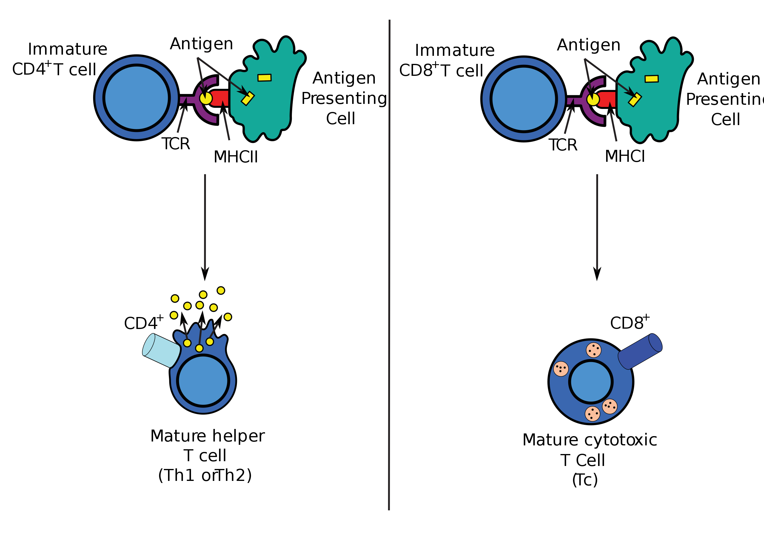
T-cell receptor (TCR)

Slide 6
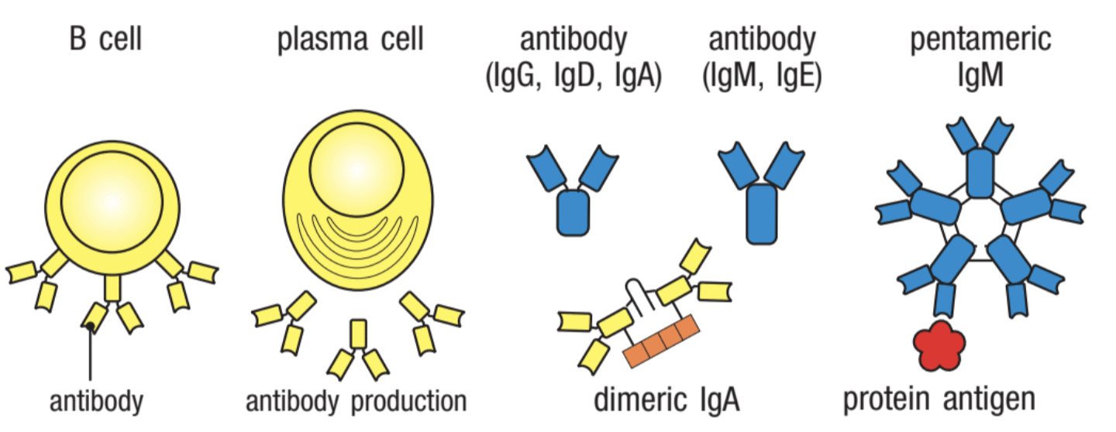
Janeway’s Immunology

Slide 7
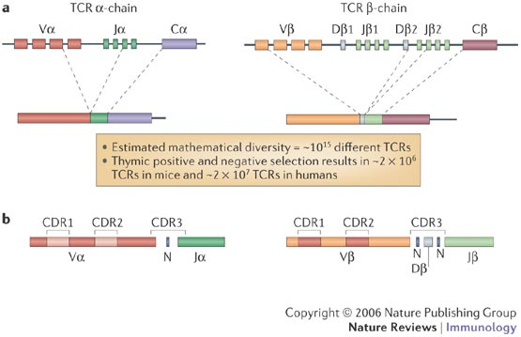
Somatic rearrangement of T-cell receptor genes
Potential TCR repertoire diversity: 10¹⁵

Slide 8
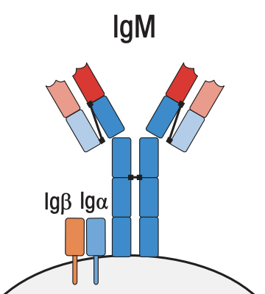
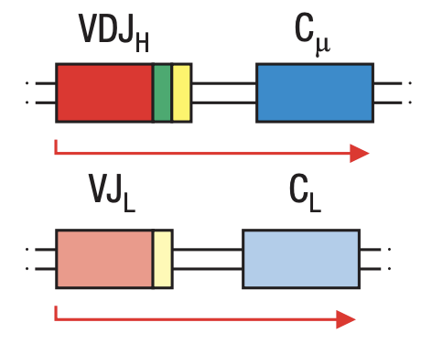
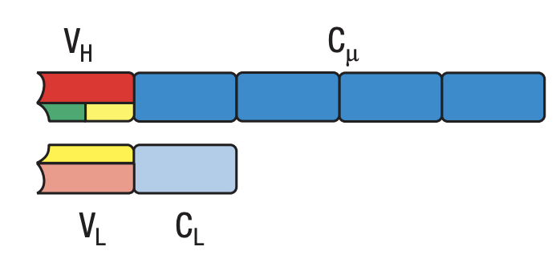
From gene to protein for the B cell receptor
Janeway’s Immunology

Slide 9
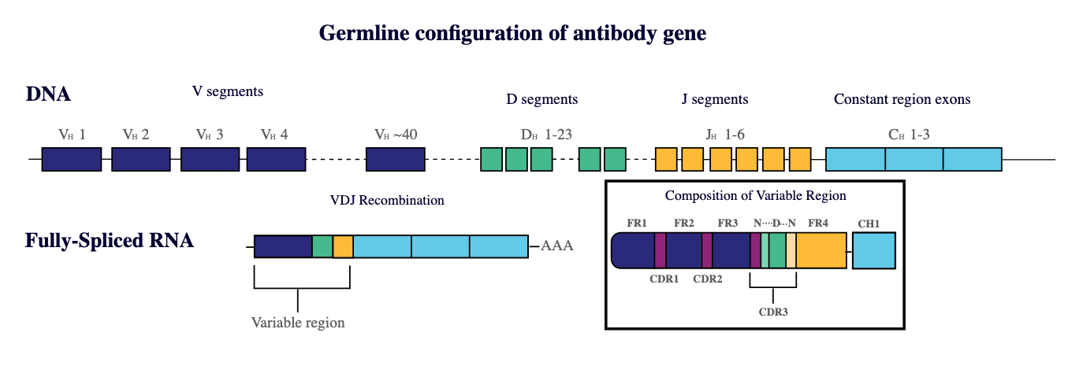
Diversity of antibody genes
iRepertoire Inc.

Slide 10
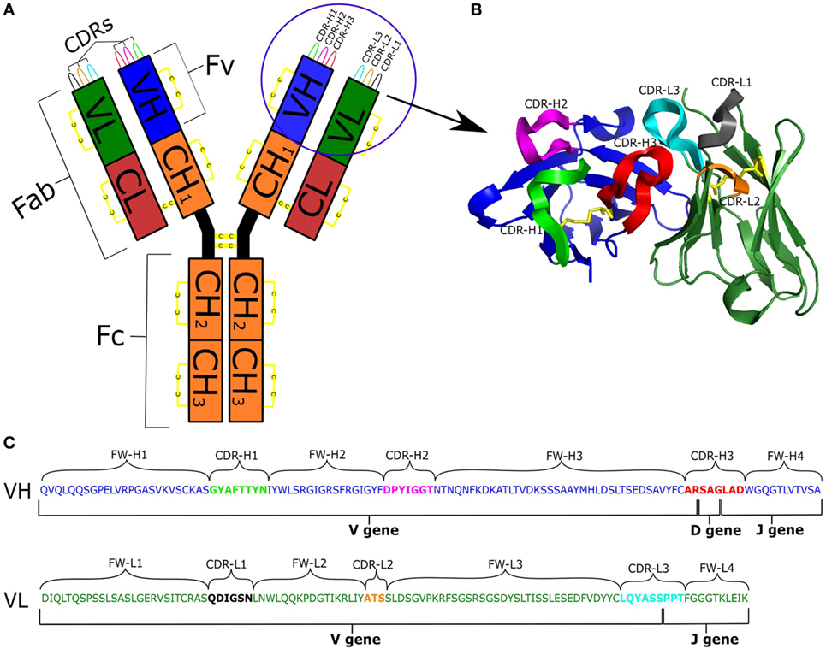
From gene to protein for the B cell receptor
Kovaltsuck 2017

Slide 11
Diversity of antibody genes
5’ end
3’ end
iRepertoire Inc.

Slide 12
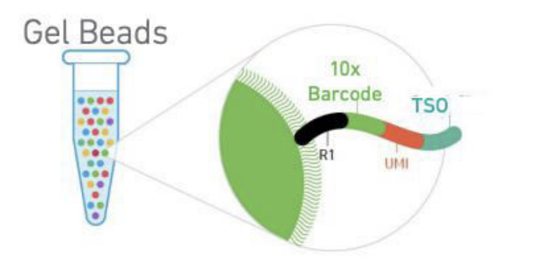
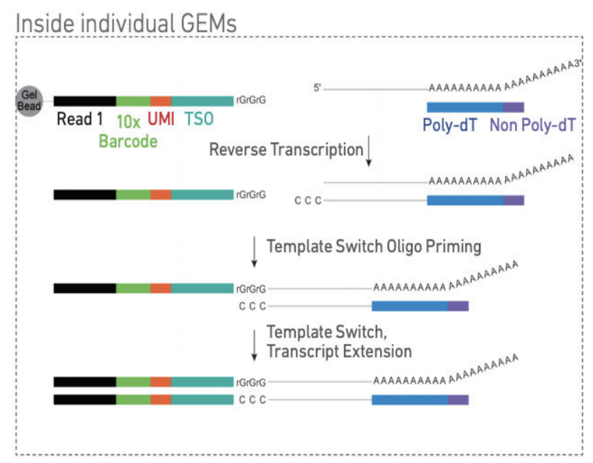
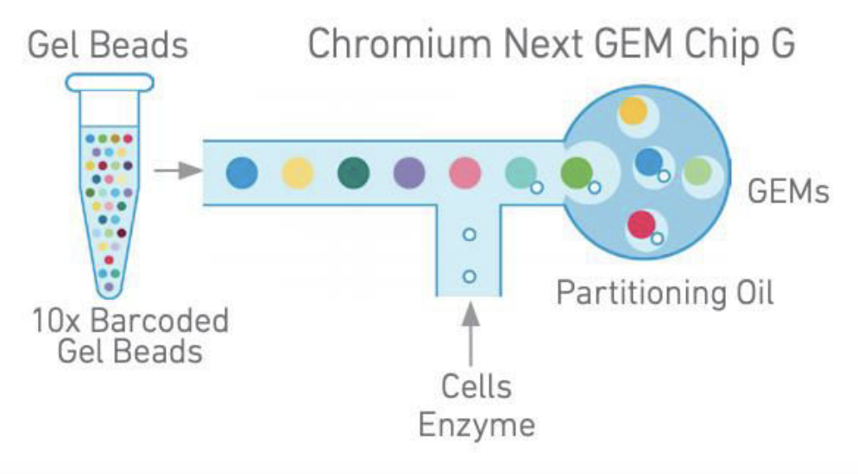
Single-cell antigen receptor sequencing with 10x genomics
10x genomics
Notes:
MMLV Reverse transcriptase adds deoxycytidine at 3’ end of newly synthesize strands

Slide 13
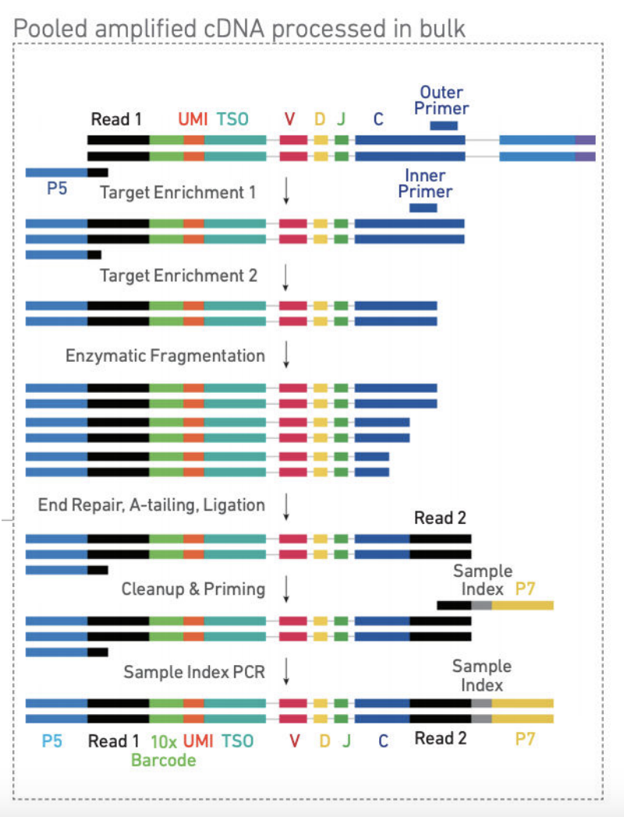
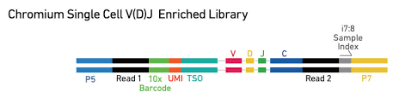
Single-cell antigen receptor sequencing with 10x genomics
10x genomics

Slide 14
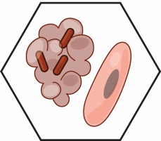
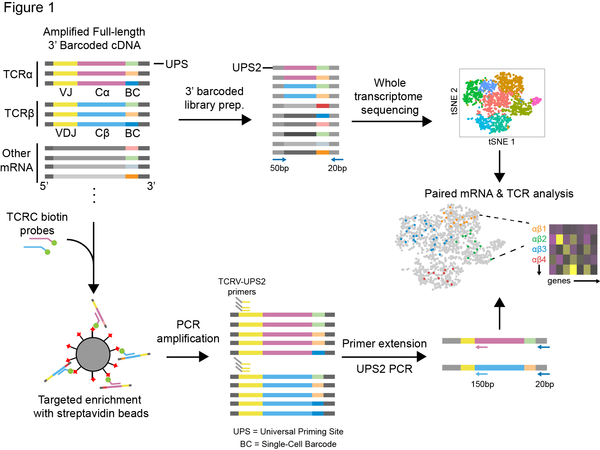
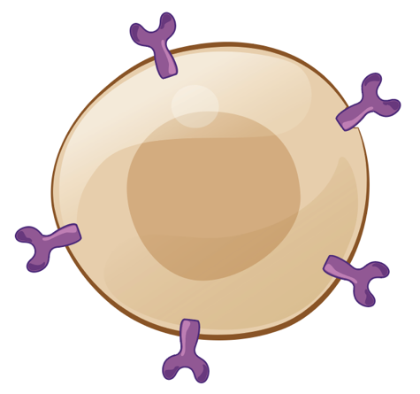
Single-Cell TCR-Seq
Notes:
-TCRα and TCRβ transcripts contained within amplified 3′-barcoded WTA products are first enriched by affinity capture using biotinylated oligonucleotide probes targeting sequences that encode the TCR constant regions, and they are then re-amplified with the same universal primer site (UPS) used in the original WTA. This step yields up to a 10⁴-fold enrichment of TCR-encoding fragments, as determined by quantitative PCR (qPCR)
-Next, the amplified pool is selectively modified by primer extension using a set of oligonucleotides comprising a shared 5′ second universal primer site (UPS2) linked to regions specific for each TCRα or TCRβ variable (V) region.
-The modified products are then further amplified with primers specific for UPS2 and an extended version of the original UPS, which is only present on the 3′ end of the library. This final amplification adds flanking regions of oligonucleotides for sequencing to the TCR-enriched library (Supplementary Table 2).
-The combination of targeted enrichment and primer extension produces a size-defined, CDR3-enriched library that does not require additional fragmentation before short-read sequencing (for example, Illumina). The resulting library can then be sequenced using custom primers targeting the constant regions of the TCR genes to directly recover the CDR3 region

Slide 15
BCR biology and single-cell detection using 10x genomics
Computational analysis of single-cell antigen-receptor data
Other single-cell multi-modal measurements relevant to immunology

Slide 16
Single-cell BCR sequencing with 10x genomics
10x genomics

Slide 17
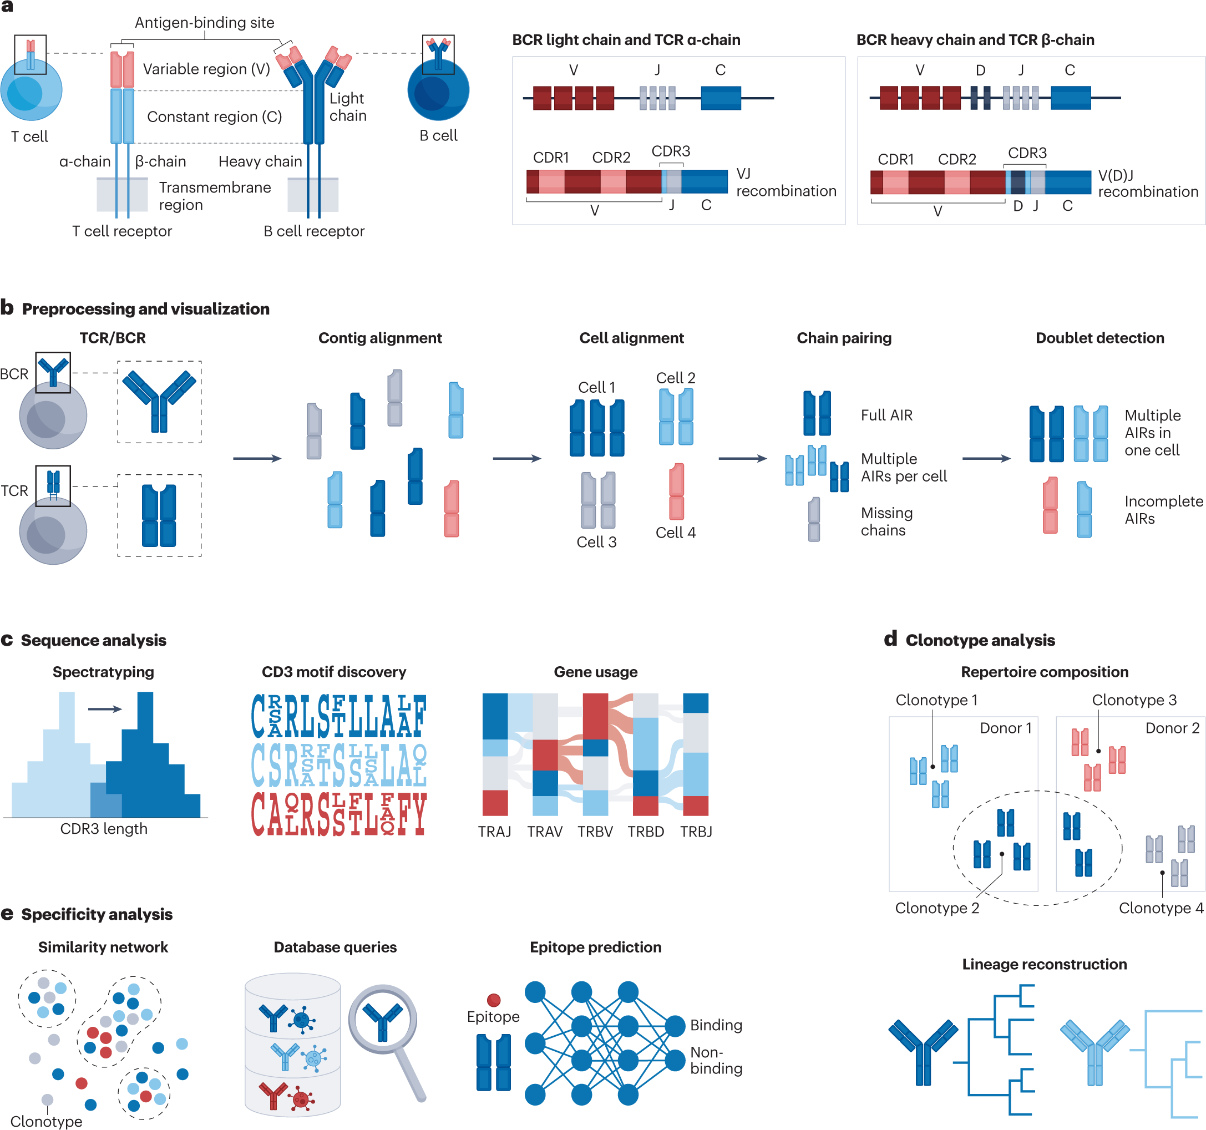
Computational analysis
Heumos, L., Schaar, A.C., Lance, C. et al. . Nat Rev Genet 24, 550–572 (2023

Slide 18
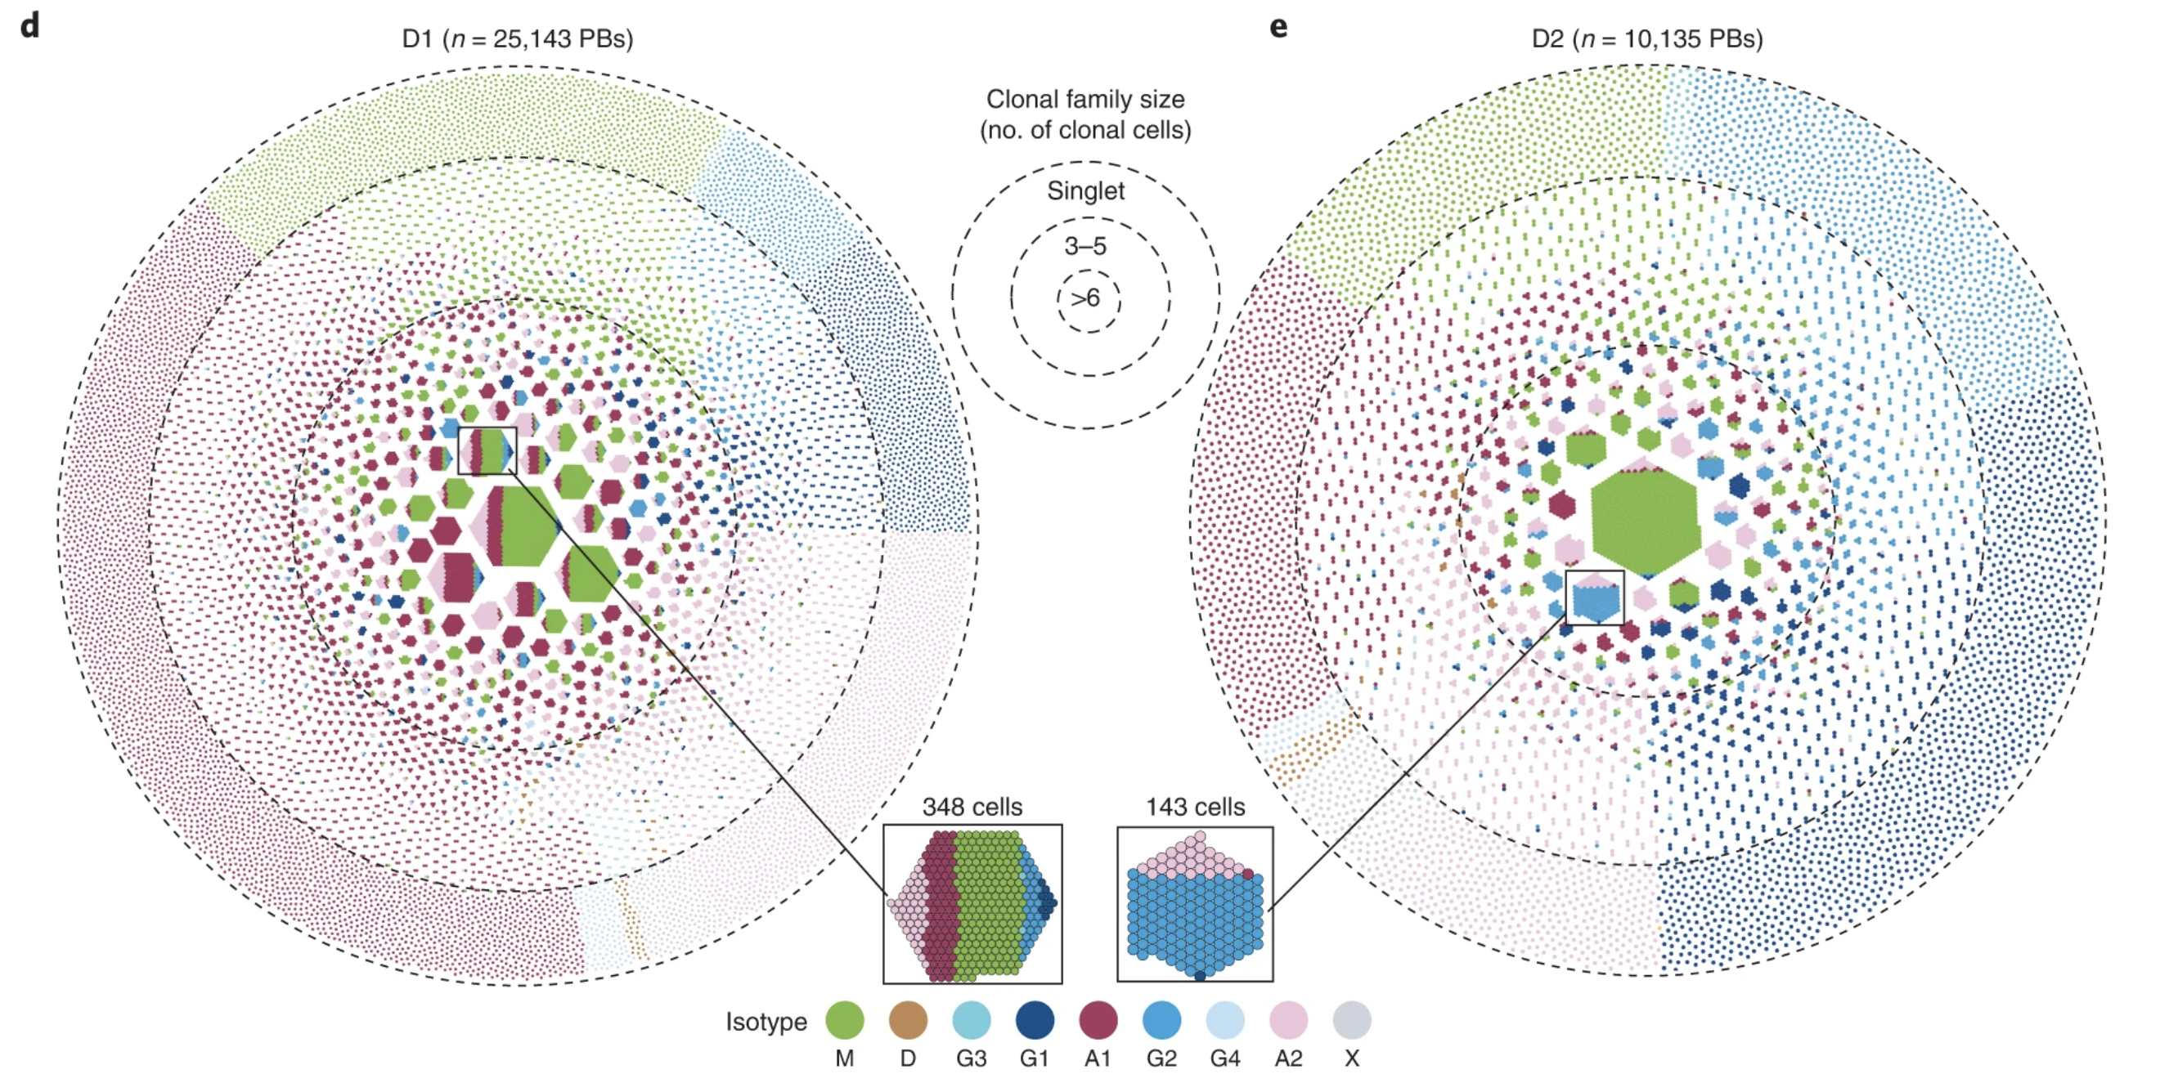
Single-cell BCR-seq to analyze the immune repertoire
Phad et al. Nature Immunology 2022

Slide 19



Several software tools exist for single-cell antigen receptor analysis
R
R
python

Slide 20
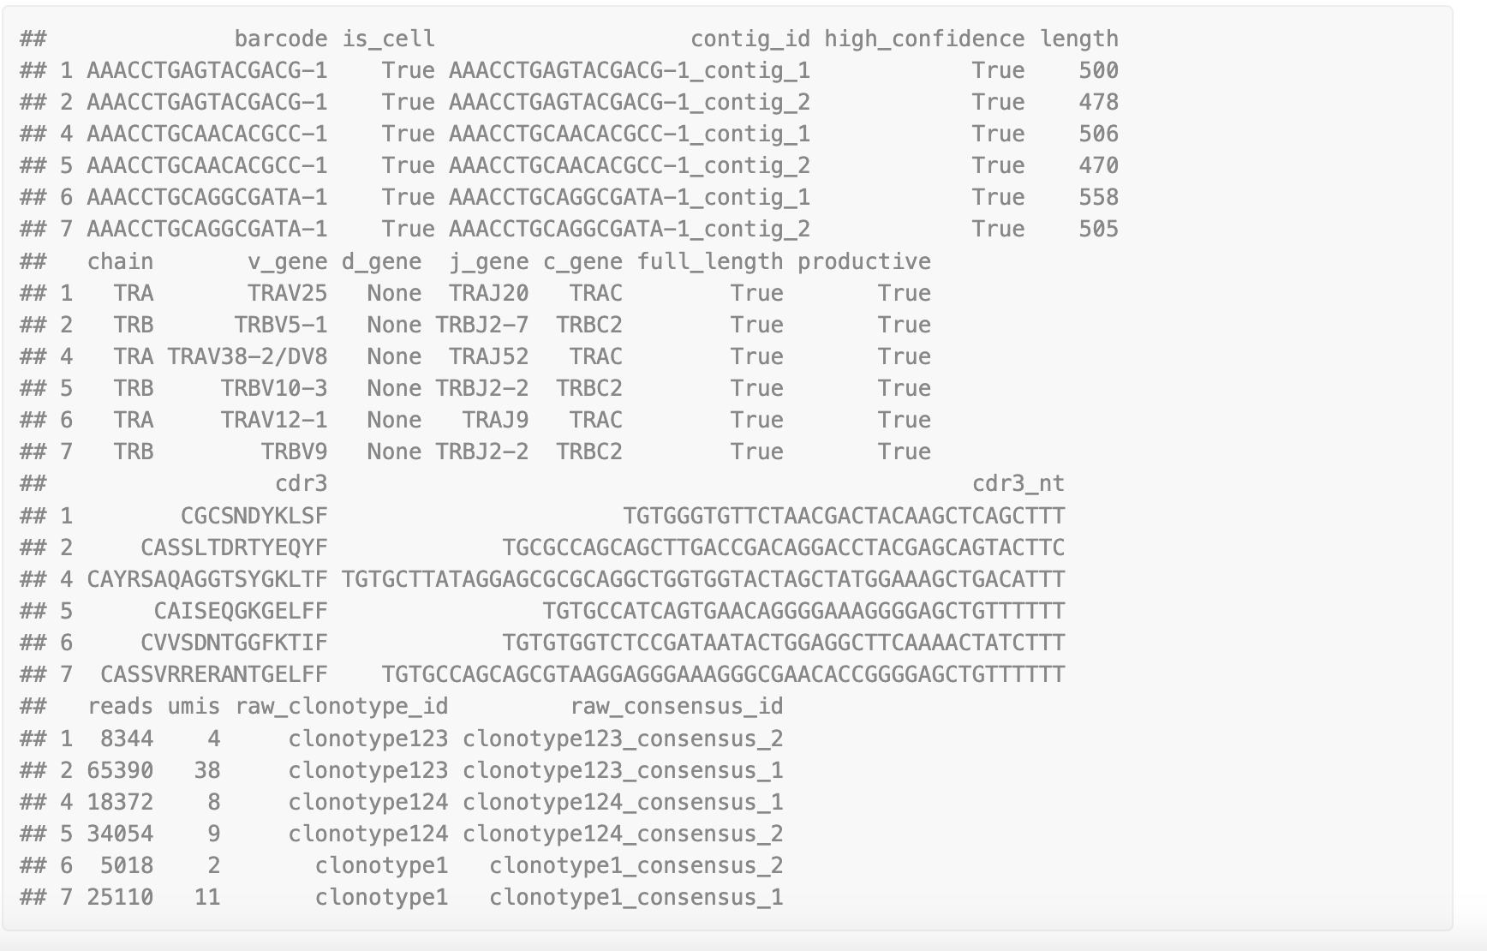
Interacting with scTCR/BCR-seq data in scRepertoire
List of contigs

Slide 21
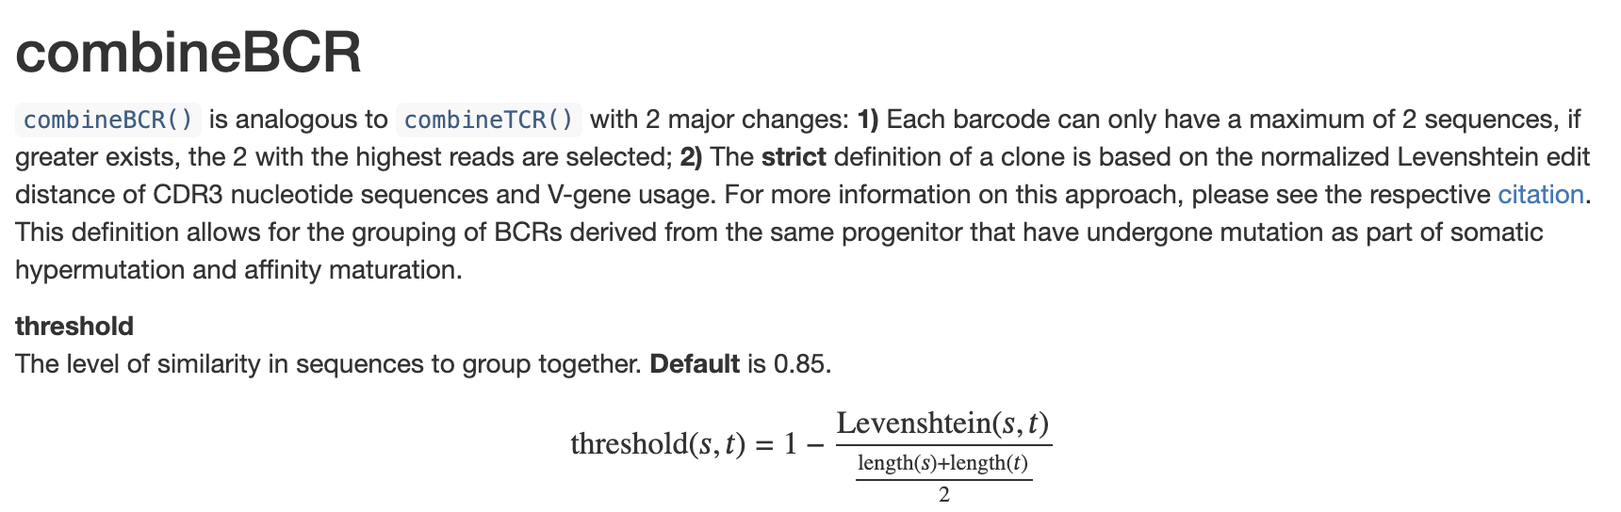
Next: combine contigs into clones
This step can be done a few days, here is how scRepertoire does it:

Slide 22
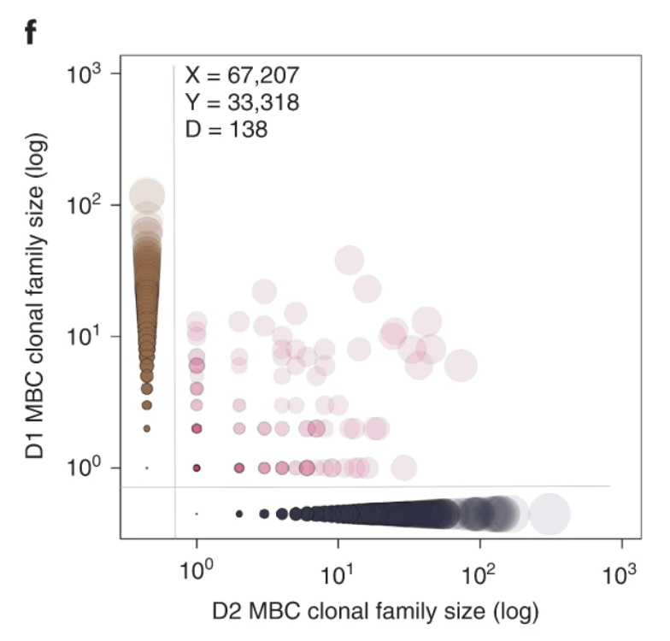
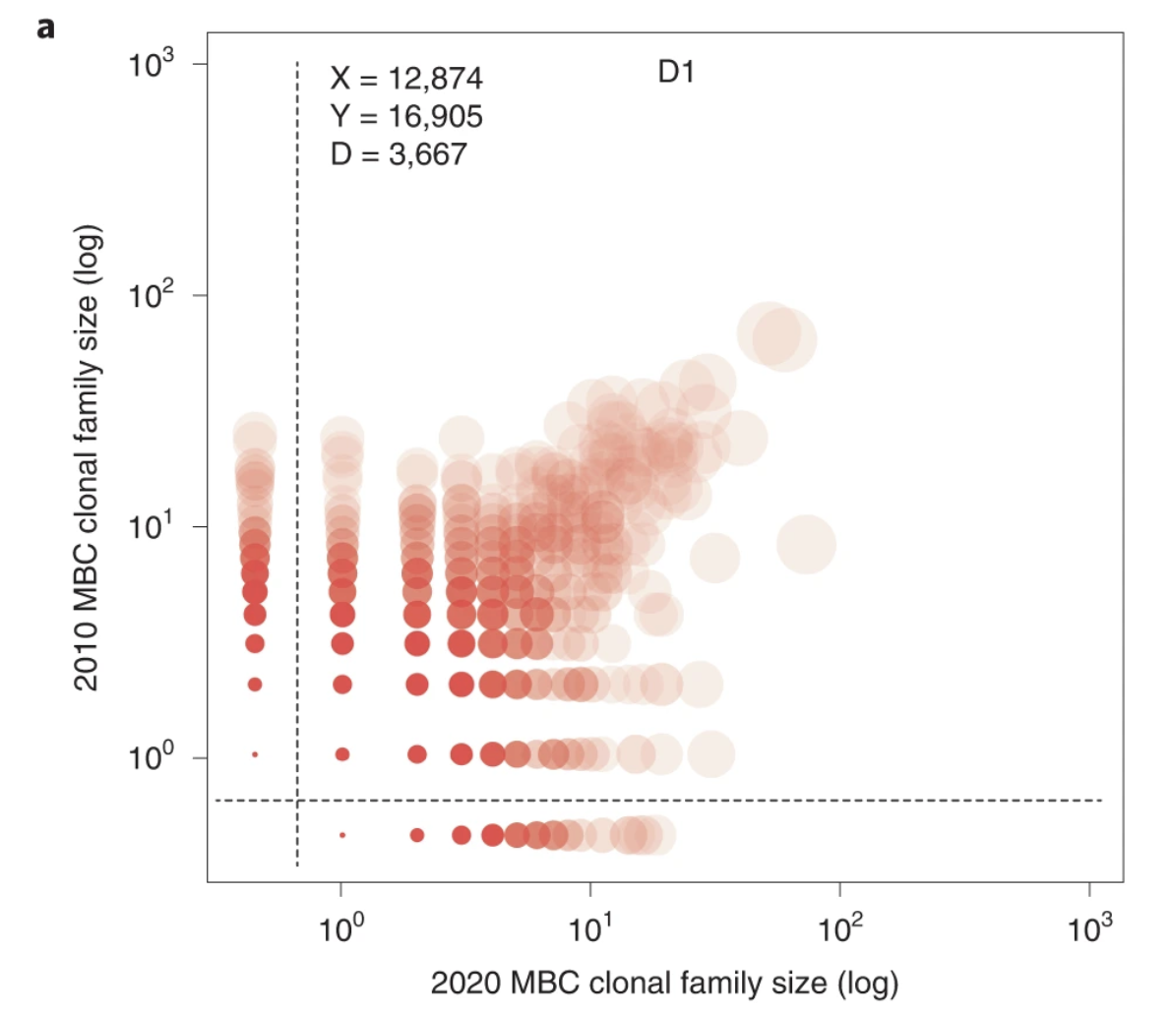
How does the immune repertoire compare between samples?
Large differences between individuals
Small differences across time (for one individual)
Phad et al. Nature Immunology 2022
Notes:
D1 and D2 are two healthy individuals. Diagonal = shared clones

Slide 23
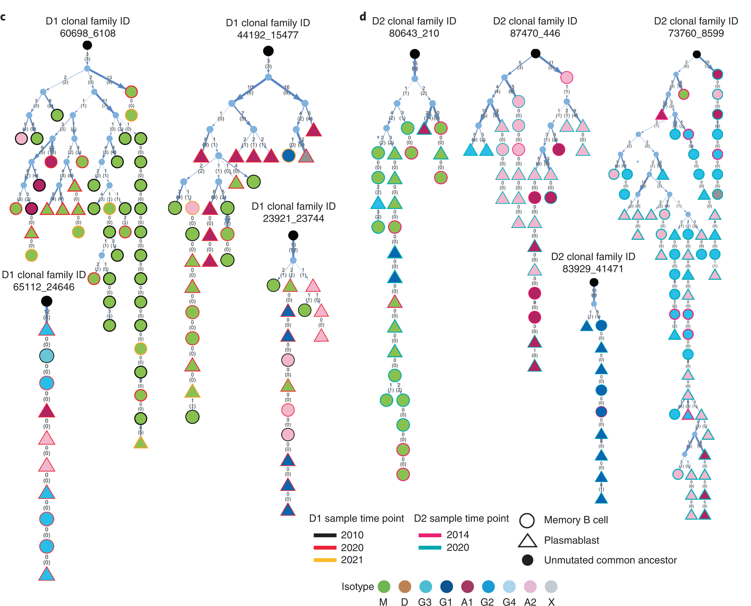
Inferring clonal relationships across cell types
Phad et al. Nature Immunology 2022

Slide 24
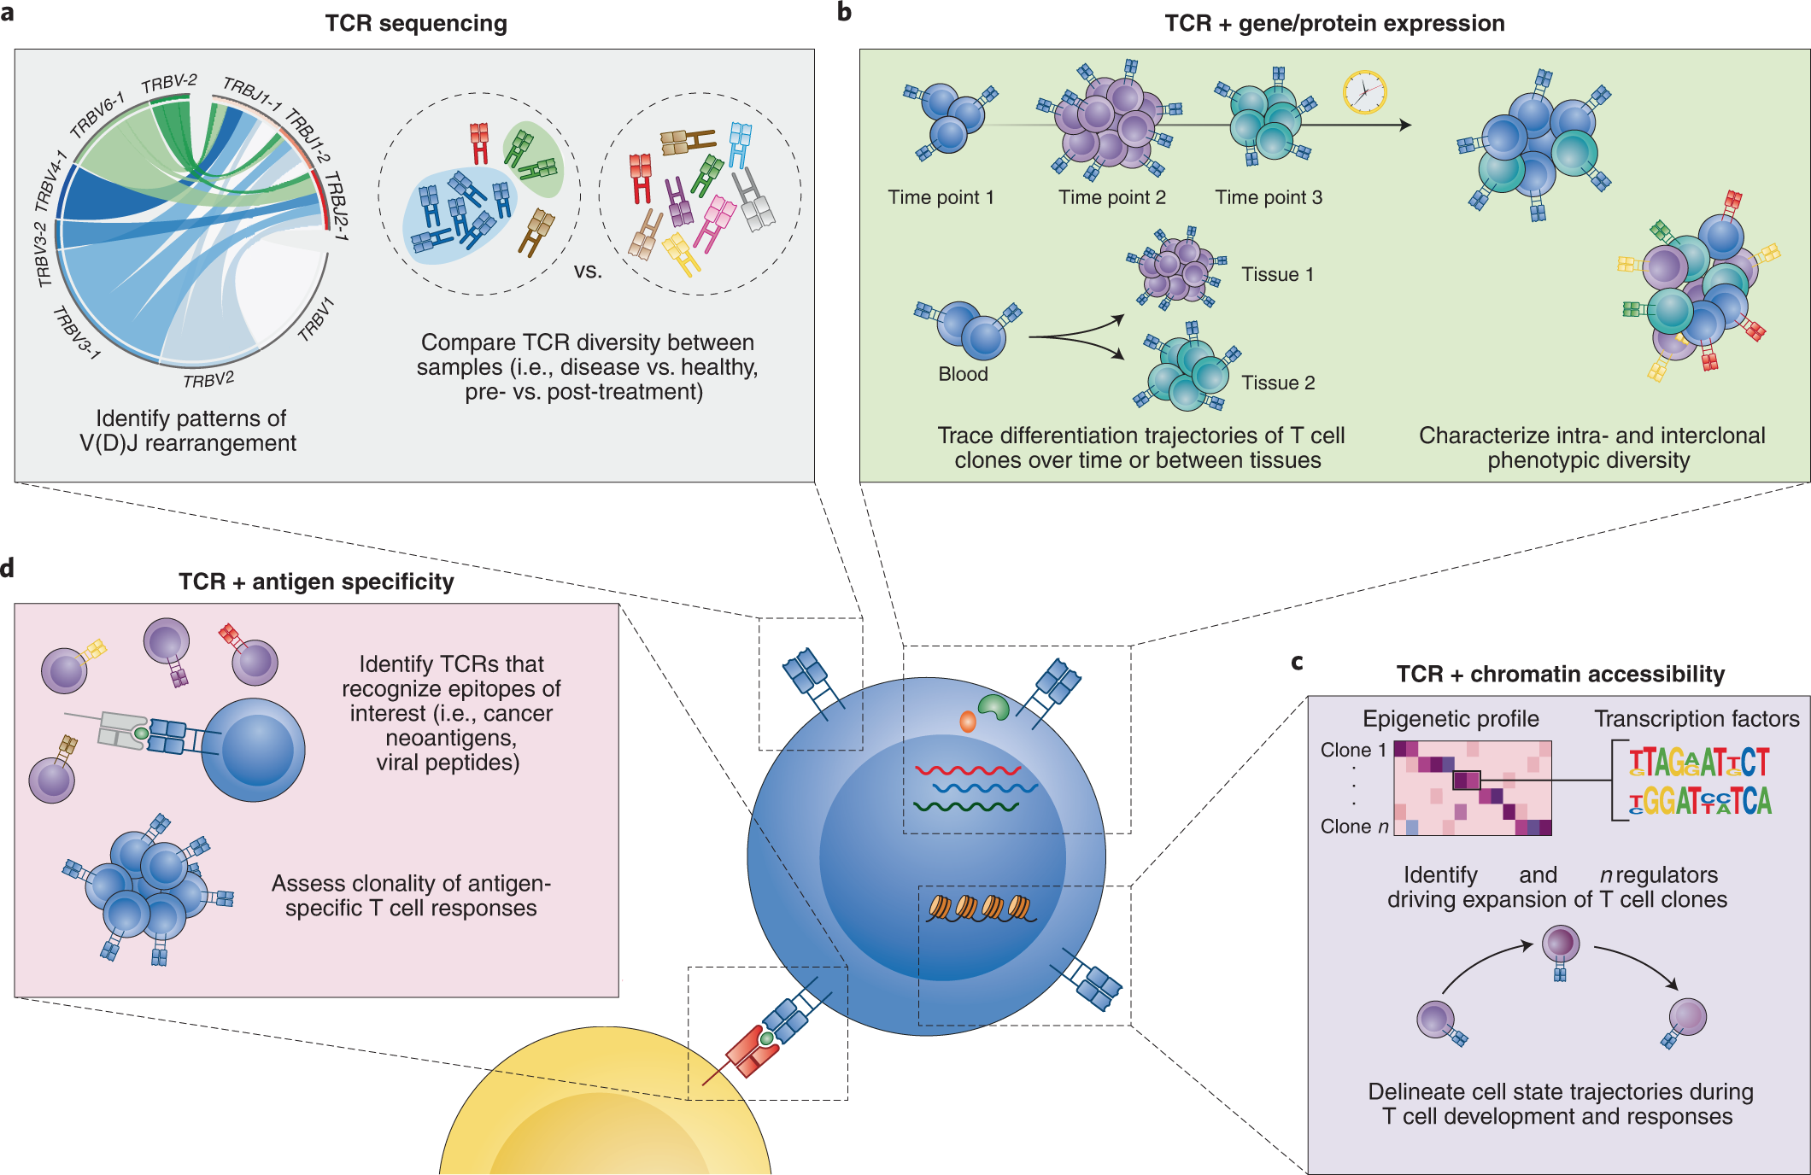
T-cell receptor sequencing
Pai, J.A., Satpathy, A.T. Nat Methods 18, 881–892 (2021). https://doi.org/10.1038/s41592-021-01201-8
Notes:
There are several aspects of the T cell response that can be best understood through analysis of the TCR repertoire. Because of the low probability of somatic recombination producing an exact V(D)J rearrangement twice in an individual³, the TCR sequence can be used as a unique identifier of T cell clones. This feature is a useful proxy for measuring (1) antigen-driven clonal expansion of T cells as an indicator of antigen specificity and response (Fig. 1a,d) and (2) longitudinal clonal dynamics and heterogeneity of the T cell response (Fig. 1b,c). Moreover, joint assessment of the TCR and cellular phenotypes in single cells can provide information on T cell differentiation pathways and the role of TCR sequence and specificity in T cell selection, activation and phenotypic specification (Fig. 1b). This information is useful not only in understanding the etiology and pathology of immune-mediated diseases, but also in designing therapeutic strategies. For example, tracking TCR diversity in patients across time points can reveal patterns of T cell clonal dynamics that correlate with treatment response or other clinically relevant features, and pairing clonal information with cellular phenotype can identify disease-relevant cell types^{8,9,10,11,12}.

Slide 25
BCR biology and single-cell detection using 10x genomics
Computational analysis of single-cell antigen-receptor data
Other single-cell multi-modal measurements relevant to immunology
Notes:
sergio

Slide 26
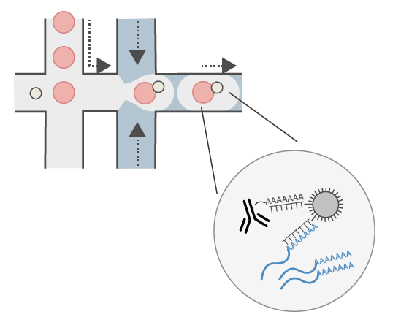
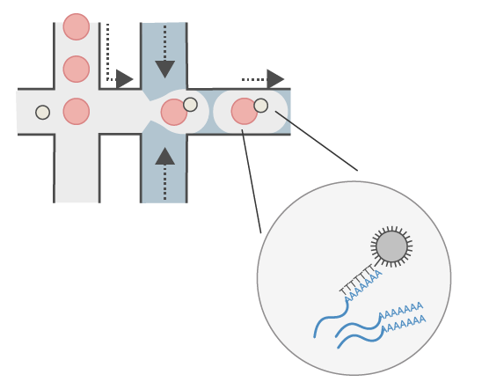
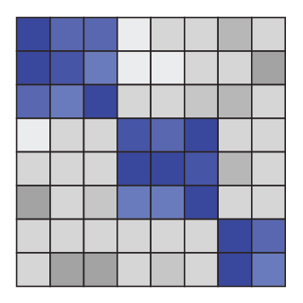
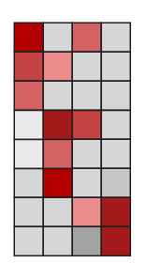
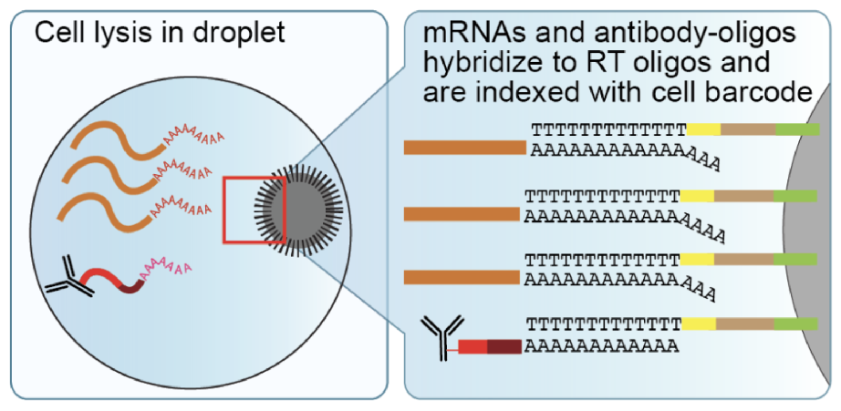
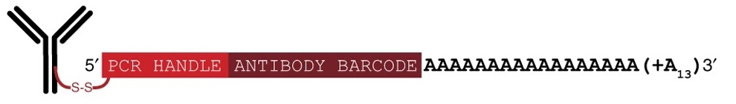
Simultaneous sequencing of proteins and RNA
Genes
Proteins
Cells
CITE-seq, REAP-seq
Stoeckius et al. 2017
Peterson et al. 2017
Poly-A tag on antibodies and mRNA captured together
Hattie Chung (Yale University)
Stoeckius et al. 2017
Notes:
To achieve this, I turned to a then-novel method, CITE-seq and REAP-seq, which showed that you can build on existing single cell transcriptomics methods to capture protein levels at the same time using DNA-barcoded antibodies.
But these method were only applicable to cell surface protein targets.
We solved several challenges to arrive at intranuclear CITE-seq, or inCITE-seq. I will describe how we adapted DNA-barcoded antibodies to measure intranuclear protein targets in a method called intranuclear CITE-seq, or inCITE-seq by overcoming key experimental challenges, and how we used this data to study how gene expression patterns genome-wide are impacted by regulatory proteins.

Slide 27
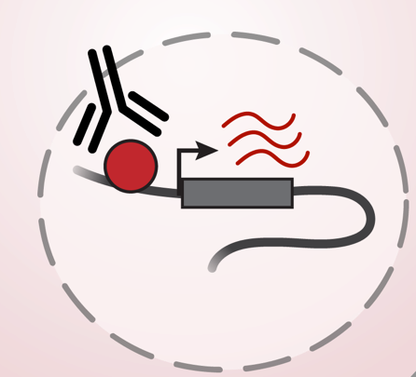
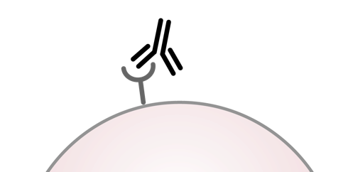
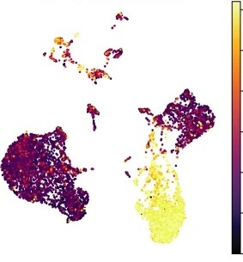
Simultaneous sequencing of proteins and RNA
Genes
Proteins
Cells
CITE-seq, REAP-seq
Stoeckius et al. 2017
Peterson et al. 2017
Used to refine cell typing using cell surface marker proteins
What about intranuclear proteins that drive cellular activities?
CD4
Hattie Chung (Broad Institute)
Gayoso et al. 2021
Notes:
To achieve this, I turned to a then-novel method, CITE-seq and REAP-seq, which showed that you can build on existing single cell transcriptomics methods to capture protein levels at the same time using DNA-barcoded antibodies.
But these method were only applicable to cell surface protein targets.
We solved several challenges to arrive at intranuclear CITE-seq, or inCITE-seq. I will describe how we adapted DNA-barcoded antibodies to measure intranuclear protein targets in a method called intranuclear CITE-seq, or inCITE-seq by overcoming key experimental challenges, and how we used this data to study how gene expression patterns genome-wide are impacted by regulatory proteins.

Slide 28
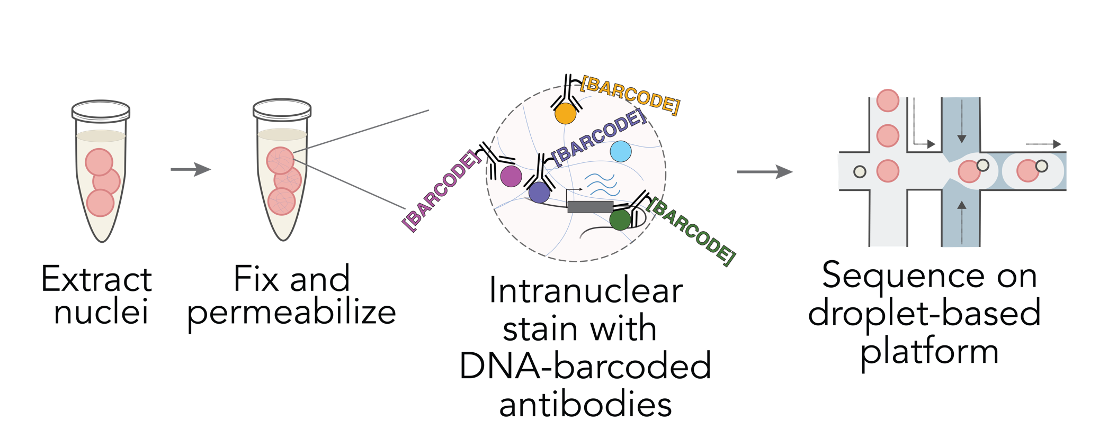
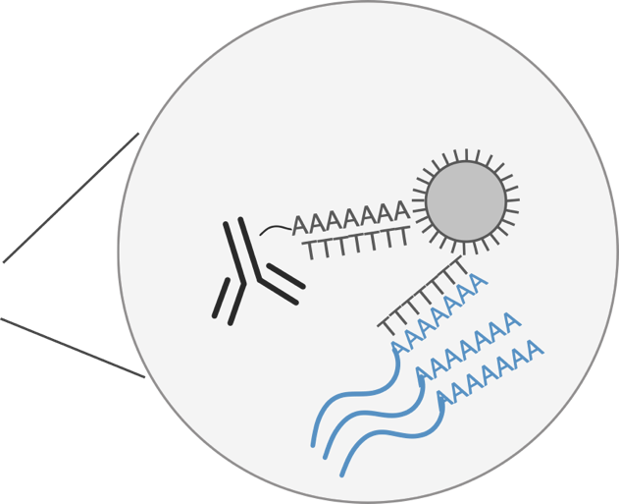
Joint single-cell measurements of nuclear proteins and RNA
Chung et al. Nat. Meth. 2021
Notes:
After optimizing, we sequenced these nuclei that were stained with DNA-conjugated antibodies which contain a polyA tail.
Then the nuclei are loaded onto a standard microfluidic device for single cell sequencing where transcripts and antibody tags are both captured.

Slide 29
Data transformation
RNA matrix (n x g)
Protein matrix (n x p)
UMIs | Gene A | Gene B | Gene C
Cell 1 | 0 | 0 | 2
Cell 2 | 1 | 1 | 0
Cell 3 | 0 | 1 | 0
UMIs | Prot 1 | Prot 2 | Prot 3 | …
Cell 1 | 28 | 243 | 85
Cell 2 | 15 | 453 | 119
Cell 3 | 32 | 378 | 52
Standard single-cell processing; log(1+p)
Centered log ratios (CLRs)
Hattie Chung (Yale University)
Notes:
We get a matrix for each cell, where we get gene counts and protein counts
NO ZERO INFLATION REFERENCE UMIs FOR PROTEINS!!!
Gene counts are processed according to standard scRNA-seq protocols
Protein counts are scaled to the centered log ratio, which is a metric used to quantify relative abundances in compositional data. We divide each protein count by the geometric mean within each batch.

Slide 30
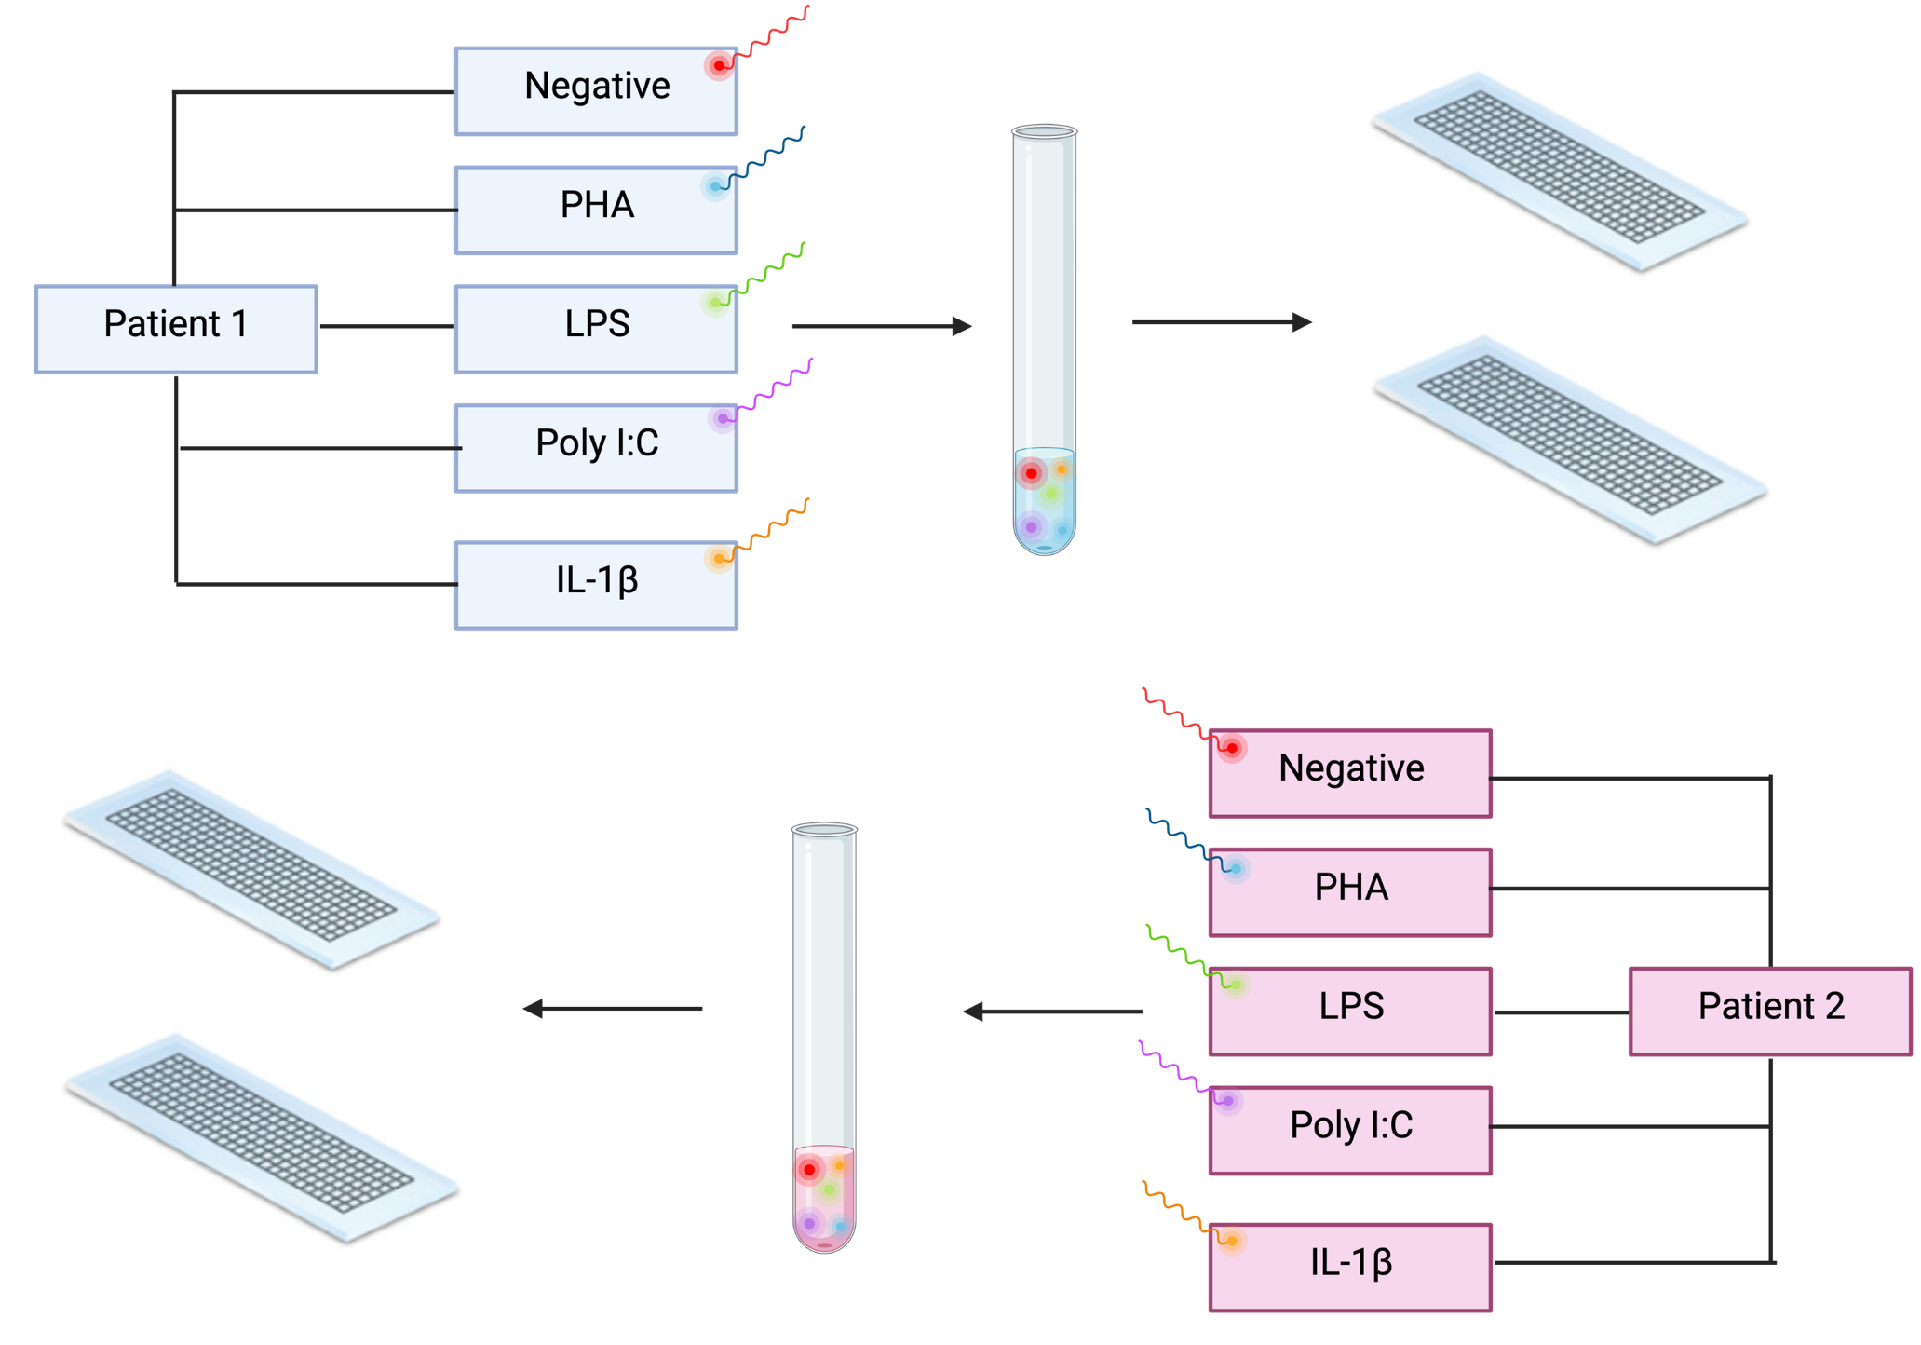

Antibody Multiplexing/Hashing

Slide 31
How do we know what the T cell is binding?

Slide 32
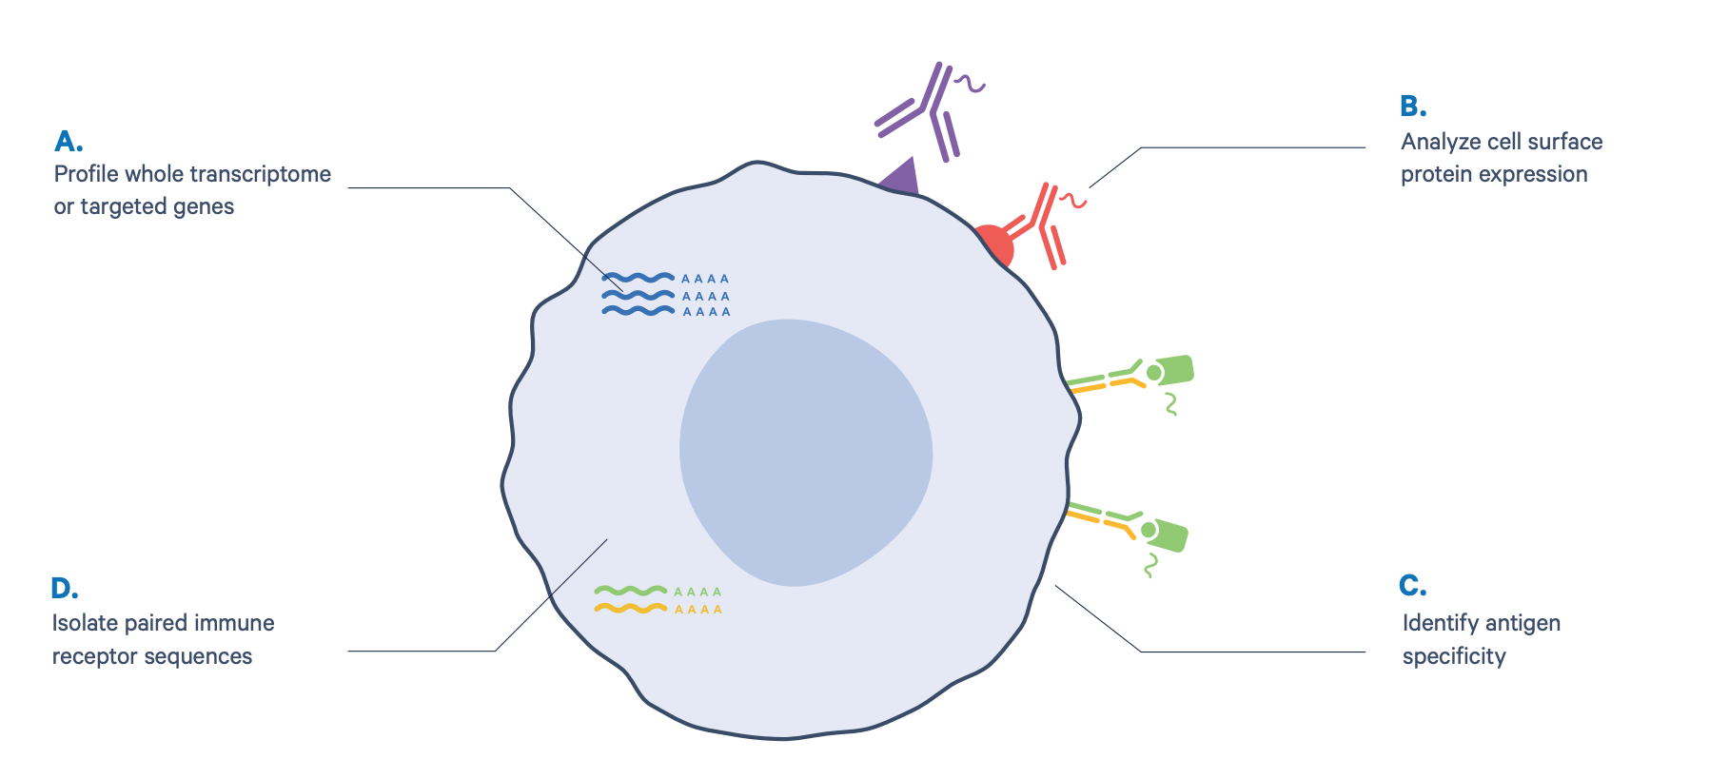

Add peptide-MHC with oligo tag to determine specificity of TCR

Slide 33
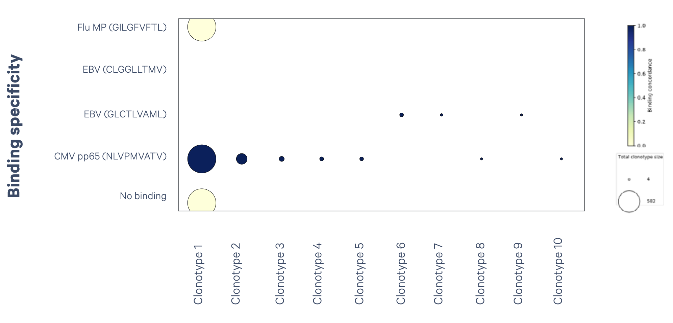
Peptide-MHC mapping tells you what the each TCR will bind and react to

Slide 34
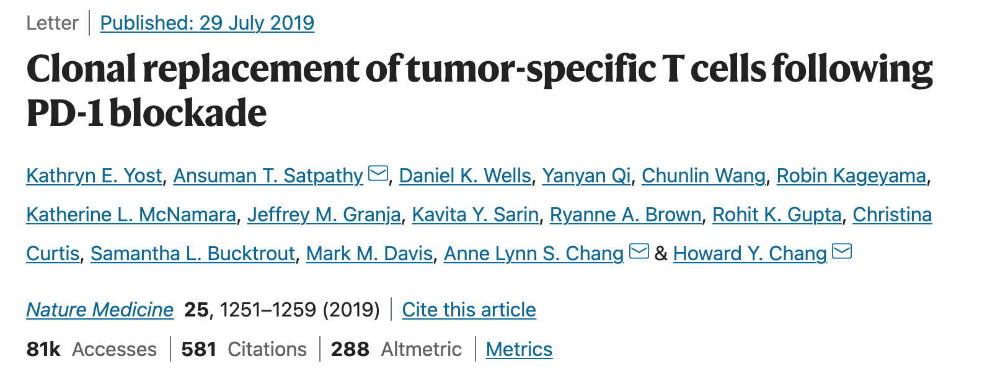
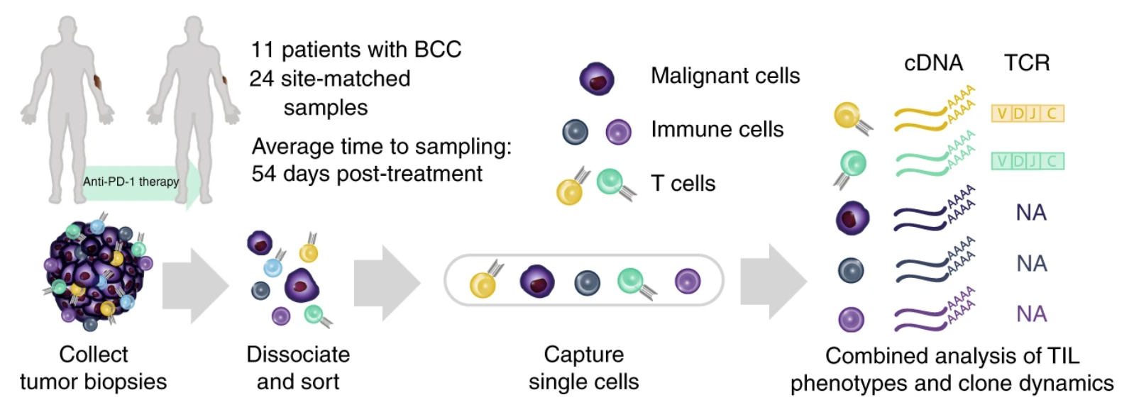

Slide 35
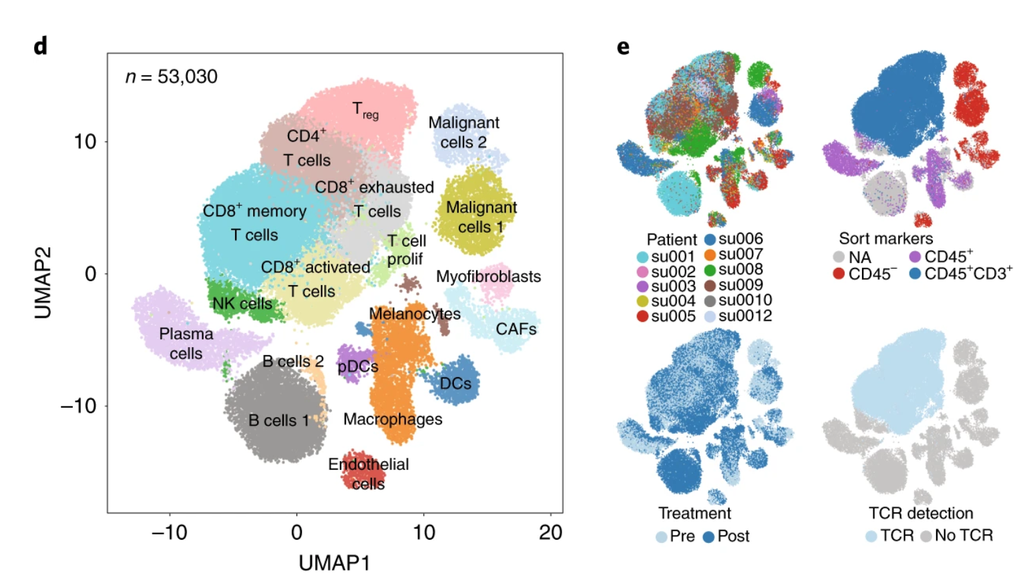
Clustering:
Is there a batch effect from patients?
Is there a batch effect from treatment?
Yost 2019, Nature Medicine

Slide 36
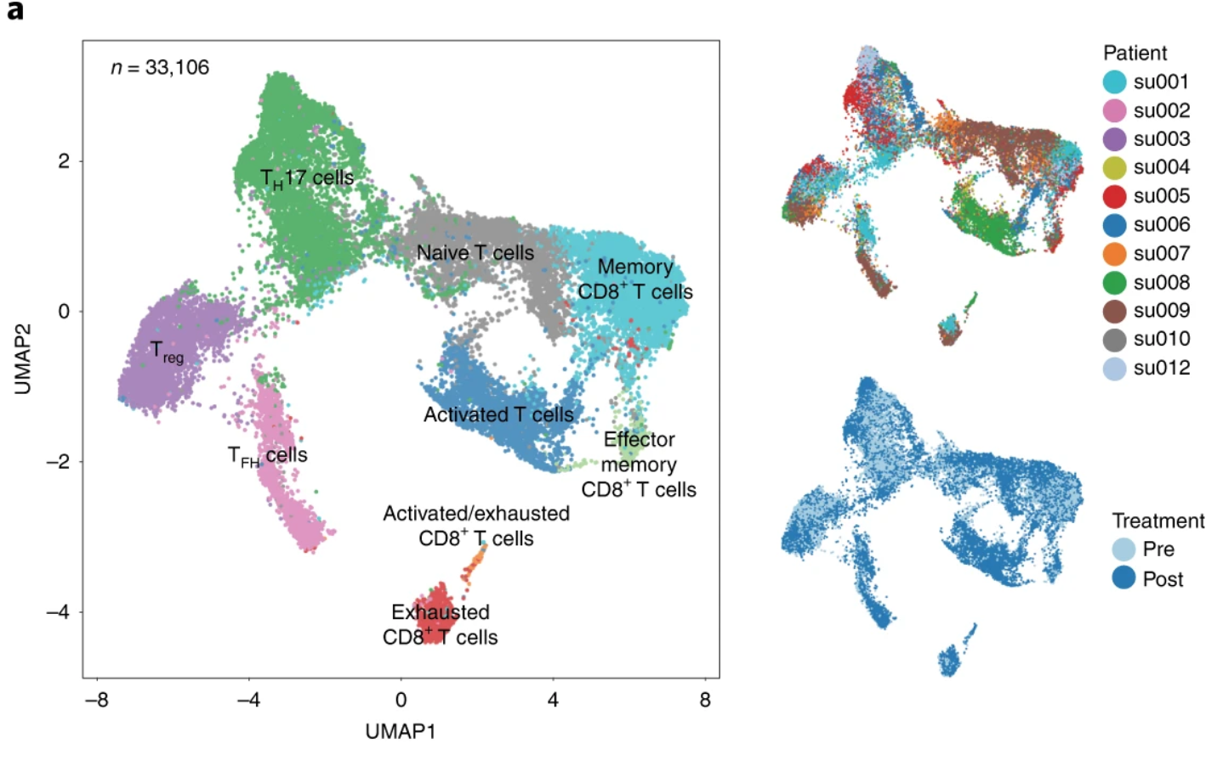
Separation of T cells and re-clustering for more detailed annotation
Yost 2019, Nature Medicine

Slide 37
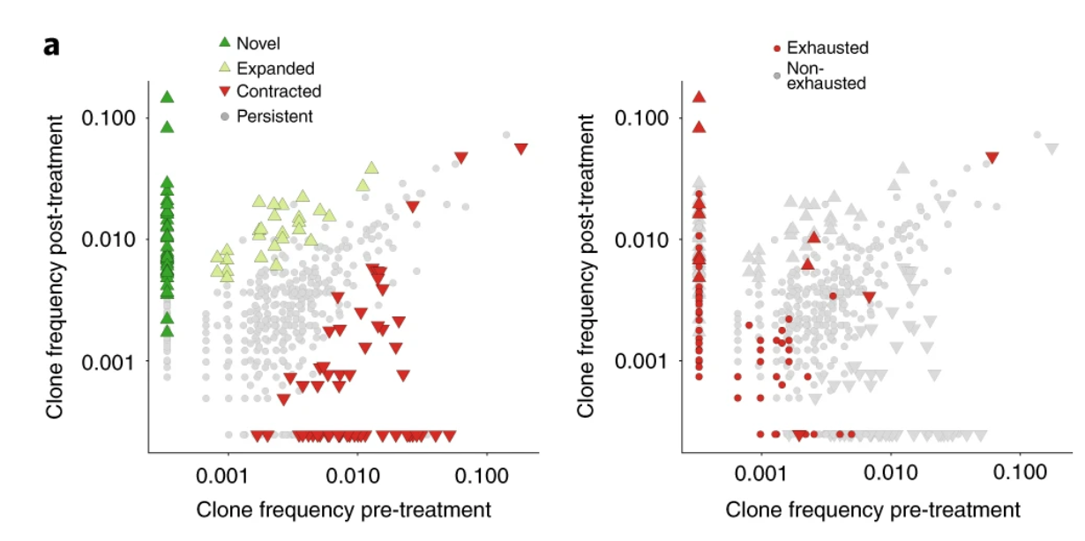
Integration of T cell receptor sequence to determine that new clones arrive in the tumor
Yost 2019, Nature Medicine

